Slide 1

8TH SEMESTER PROJECT REVIEW
PHASE-III
PROJECT TITLE :
RISK MANAGEMENT IN ONLINE RECHARGE SYSTEM
Under the guidance of
S. RAJESWARI MAAM
(SENIOR ASST. PROFESSOR)
Submitted by
RAHUL KUMAR (1NH13IS084)
NAVEEN KUMAR JANGID (1NH13IS129)
SANTOSH KUMAR YADAV (1NH13IS131)

Slide 2
CONTENTS:
1.Introduction
2.Existing system
3.Proposed system
4.System Architecture
5.Dataflow Diagram levels
6.References

Slide 3
1.INTRODUCTION
Risk Management can be defined as a systematic process for identifying, analysing and controlling risks in projects or organizations.
Analyse risks in an automated recharge system, consequently enhancing the usability.
Currently the existing system of online recharge system poses the risk of our credit/debit card details being hacked or misused.
The proposed system minimizes the risk by avoiding the use of credit/debit cards for payments.

Slide 4
2.EXISTING SYSTEM
Client side:-
User logs into account by providing his/her login credentials.
Generates a new recharge request with mobile number and recharge amount
Sends recharge request.

Slide 5
Server side:-
Client request is stored at database.
Process the request by sending a message to operator to complete recharge using SMSC(short message service center) server through recharge sim.
Acknowledgment and store status report in database.
Generate recharge report and billing amount.

Slide 6
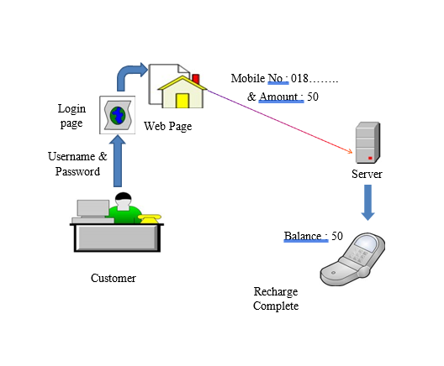

Slide 7
3.PROPOSED SYSTEM
There is always a risk in using credit/debit card details on web portals.
Even the most secure payment gateway using encryption has the
risk to be hacked.
In the proposed system, we try to minimize the risk by automating
the recharge process using digital wallet and totally removing the
usage of credit/debit card details for payment.
The automation is done when a certain threshold is reached.
2 types of threshold:-
    Time based
    Volume based

Slide 8
TIME BASED THRESHOLD
When a certain time period has expired, the system will inform the user
by sending a SMS containing related information.
VOLUME BASED THRESHOLD
When the specified volume has expired, the system will inform the user
by sending a SMS containing related information.
When either of the threshold is exceeded, the recharge is done
automatically by deducting the amount from the digital wallet.
The digital wallet is linked with the users bank account by using his
registered mobile no. i.e., using UPI(Unified Payment Interface).
At the start of the every month the digital wallet is loaded with certain
amount of money directly from bank account.

Slide 9
CATEGORIES OF RISKS
Schedule Risk: Project schedule get slip when project tasks and schedule release risks are not addressed properly.
Budget Risk: Wrong budget estimation, Cost overruns, Project scope expansion.
Operational Risks: Risks of loss due to improper process implementation, failed system or some external events risks.
Technical Risks: Technical risks generally leads to failure of functionality and performance.
Programmatic Risks: These are the external risks beyond the operational limits. These are all uncertain risks are outside the control of the program.

Slide 10
TYPES OF RISKS
Validating the correct username and password combination.
Checking the strength of the password.
Password should not be visible and should be hidden under asterisks.
Threshold should be checked properly.
Checking for enough balance in digital wallet when needed.

Slide 11
5.ALGORITHMS /METHOD USED
The files listed below are used in implementation of Automated Online Recharge System:
SL NO. | File | Function
1. | login.html | Consists of HTML form which takes the user details and submits to homepage.html
2. | homepage.html | Gives the user the options to load the wallet money, recharge and setting the threshold limit.
3. | callsimulate.html | Calls the given mobile number and the balance is reduced on time basis.
4. | Wallet.php | It contains the logic of the various functions such as saving ,connecting and retrieving the user details from the database, updating wallet balance, setting threshold limit etc.

Slide 12
4.SYSTEM ARCHITECTURE
Level 1
Web application
Enter details
Sends data to database
Level 2
Level 3
New request generated
End users
Search customer
Customer Database
Server
Recharge complete
Mobile application
Sends customer information to server
Sends balance status

Slide 13
5.DATAFLOW DIAGRAMS LEVELS
Level 1:
User
System
Server
Fills form
Send request
Data retrieved
Customer database

Slide 14
Level 2:
System
Server
Customer verified
User
Fills form
Send request
Recharge completed
Data
retrieved
Customer database
Recharge details
Send
Recharge request generated

Slide 15
System
Level 3:
Signal sent when threshold is reached
Time threshold/
Volume threshold
Time threshold
Customer’s mobile phone
Volume threshold
Main server
Recharges the mobile phone

Slide 16
PAPER PUBLICATION DETAILS
1st Paper Publication details:
Publication title: A REVIEW ON REQUIREMENT ENGINEERING IN RAPID APPLICATION DEVELOPMENT
Journal: International Journal of Scientific Research in Computer Science, Engineering and Information Technology
Abstract: Rapid Application Development is one of the most widely used strategies for Software Development. But with these developments there have been cases of failures in projects and the success rate has fallen. The system proposed improves the Requirement Engineering phase and improves the development strategy by a lot of paces. This system is effective in terms of time, cost and is well managed in terms of reducing errors and risks.
Authors: P.Maheshwaran¹, Rahul Kumar¹, S.Rajeswari², Dr. Jitendranath Mungara³

Slide 17
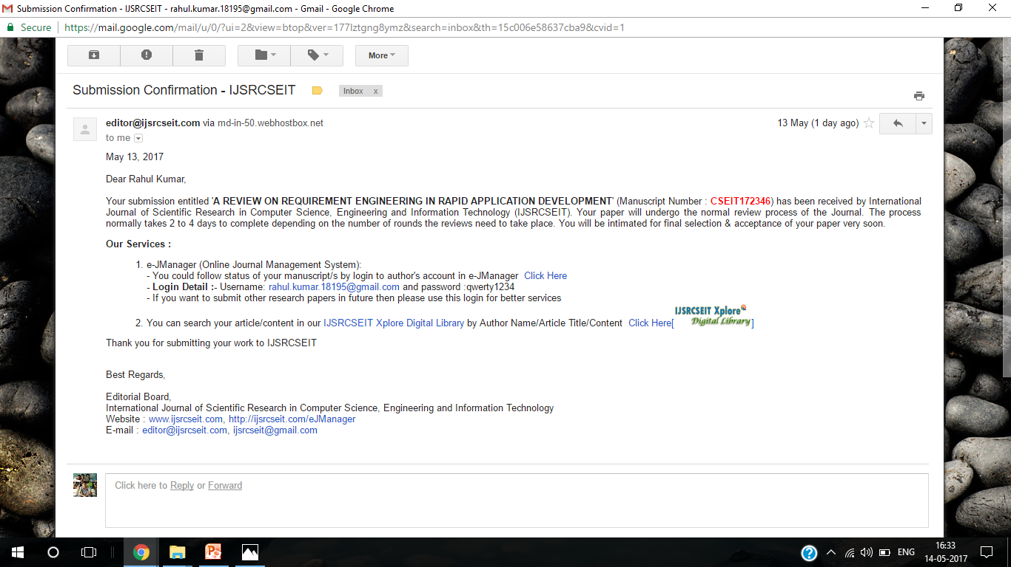

Slide 18
2nd Paper Publication details:
Publication title: A SURVEY ON AGILE SOFTWARE DEVELOPMENT METHODOLOGIES.
Journal: International Journal of Scientific Research in Computer Science, Engineering and Information Technology
Abstract: Agile software development is rapidly gaining a lot of interest in the field of software engineering. Agile software development, despite its novelty, has become an important domain of research within the software engineering discipline. Agile software development methods have attracted many software engineers and researchers worldwide. But, unfortunately there is scarcity in scientific research, there has been little detailed reporting on the usage, penetration and success of agile methodologies in traditional, professional software development organizations. This paper aims to analyse, organize and make sense out of the dispersed field of agile software development methods.
Authors: Santosh Kumar Yadav¹, Naveen Kumar Jangid¹, S.Rajeswari².

Slide 19
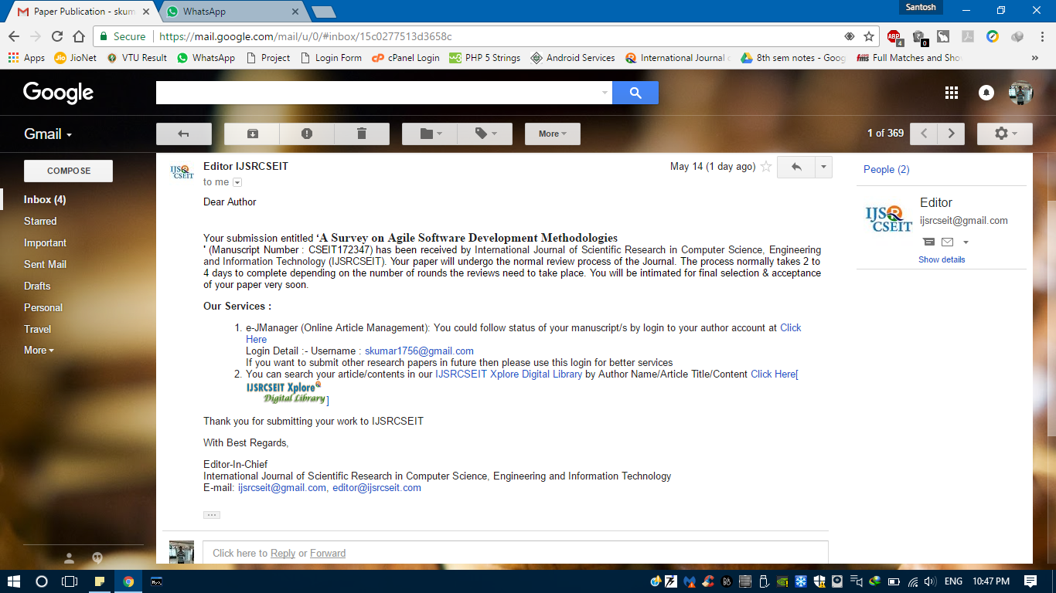

Slide 20
6.REFERENCES
Automated recharge of prepaid mobile phones - Published in: Computer and Information Technology (ICCIT), 2012 15th International Conference.
Risk Management in software engineering: A scoping study - Published in: Evaluation & Assessment in Software Engineering (EASE 2012), 16th International Conference.
Sergey M. Avdoshin, Elena Y. Pesotskaya, Software Risk Management. In: IEEE, 2011.
Shoaib Hassan , Usman Qamar , Muhammad Arslan Idris, Purification of Requirement Engineering Model for Rapid Application Development. In: IEEE, 2015.
Ian Sommerville, Software Engineering, Pearson Education, 8th Edition (2011).
B. Prashanth Kumar, Y. Prashanth, Improving the Rapid Application Development process Model. In:IEEE, 2014.
Extreme Programming. What is Extreme Programming? [Online] Retrieved 18th April 2017.Available at: www.extremeprogramming.org
Agile Methodology. What is Agile Methodology? [Online] Retrieved 18th April 2017.Available at: http://agilemethodology.org/

Slide 21
Thank you…

